Slide 1

Introduction to Robotics ME 639: Industrial Project Final Presentation
Project Title: Joint Impedance Control
Team Name: The Usual Suspects
Team Members: Jaydeep Ramnani | Navneet Kaur | Srujan Pandya
Instructor: Prof. Harish PM
Teaching Assistant: Suraj Borate

Slide 2
Problem Statement:
“Joint Impedance Control for an Existing Exoskeleton Incorporating Patient Interaction/Effort.”
Industry name: Timetooth
Objectives:
Model a 1-DOF Knee Joint-Shank Link rotational system
Incorporating Patient Interaction\Effort
Using Impedance Control Method
Determining Motor Torque, Patient Torque and Reaction Torque for the two cases:
100% Patient Effort
0% Patient Effort
1

Slide 3
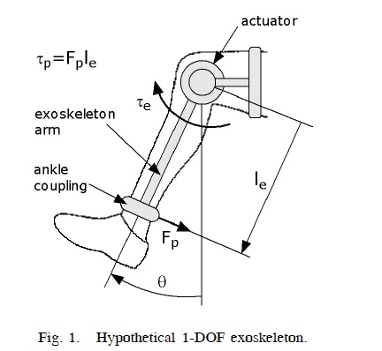
Rationale / Approach / Ideas:
The exoskeleton is assumed to be a single link, 1-DOF system. A motor is attached to move the exoskeleton and the patient’s limb.
Step 1: 100% Patient Effort
the patient is able to apply the required effort to move the limb along the required trajectory. Thus, the motor has to compensate the mass of the exoskeleton and move only the exoskeleton along the required trajectory. The patient torque is then considered as a feedforward term.
Step 2 – 0% Patient Effort
The patient is incapable of applying the required effort to follow the trajectory. The motor will have to provide a torque that will move both the patient’s limb as well as the exoskeleton. This patient effort is incorporated as an unknown disturbance to the system.
Image Source: Link
1-DOF exoskeleton
2

Slide 4
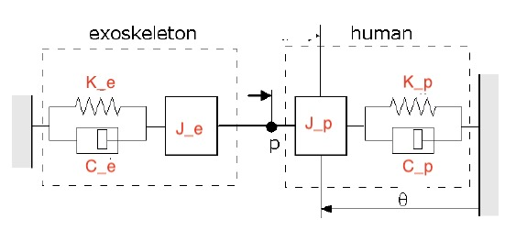
Rationale / Approach / Ideas:
Modelling:
Both the exoskeleton and the patient links act equivalent to a spring-mass-damper.
Therefore, in the control law (Appendix), the inertia matrix, the stiffness coefficient matrix and the damping coefficient matrix appear.
Since in both the subsystems, only one-dimensional motion (1 DOF) is considered, the matrices reduce to the specific values of equivalent inertia (of the link), stiffness and damping coefficient.
The port ‘p’ is where the interaction between the two subsystems take place. Therefore, the interaction force acts at the connecting port on both the limb and the exoskeleton.
Image Source: Link
Equivalent Spring-Mass-Damper System
3

Slide 5
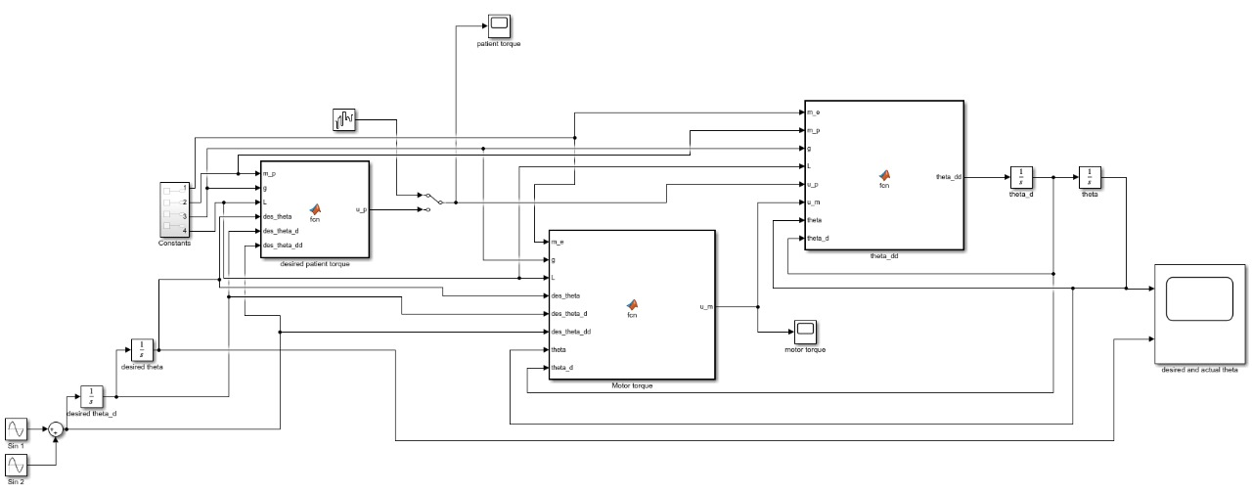
SIMULINK MODEL:
Both the cases are incorporated into one model, where a manual switch controls which case needs to be applied.
4

Slide 6
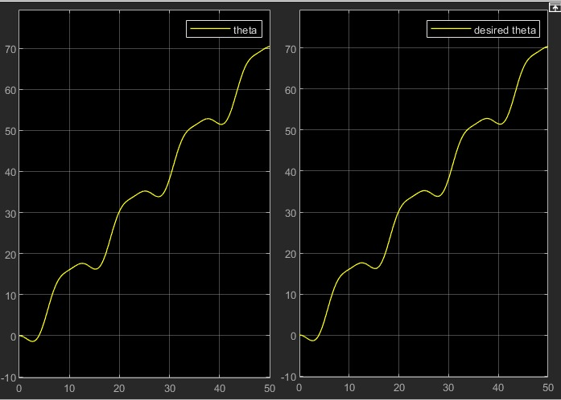
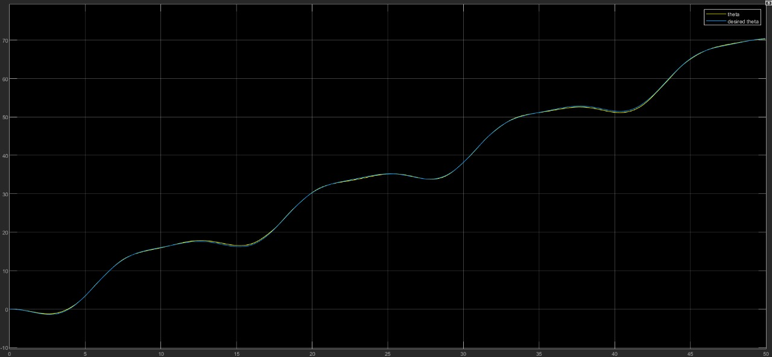

Key Results 1: Desired vs Actual $θ−Profile$ Comparison for the Two Cases
Case 1: Patient effort is sufficient to follow the trajectory (100% effort)
Case 2: A random disturbance is added as the patient torque to the system
Results: In both the cases, the trajectory is followed by the robot, ensuring that the controller is able to control the system and the system will move as desired.
5

Slide 7
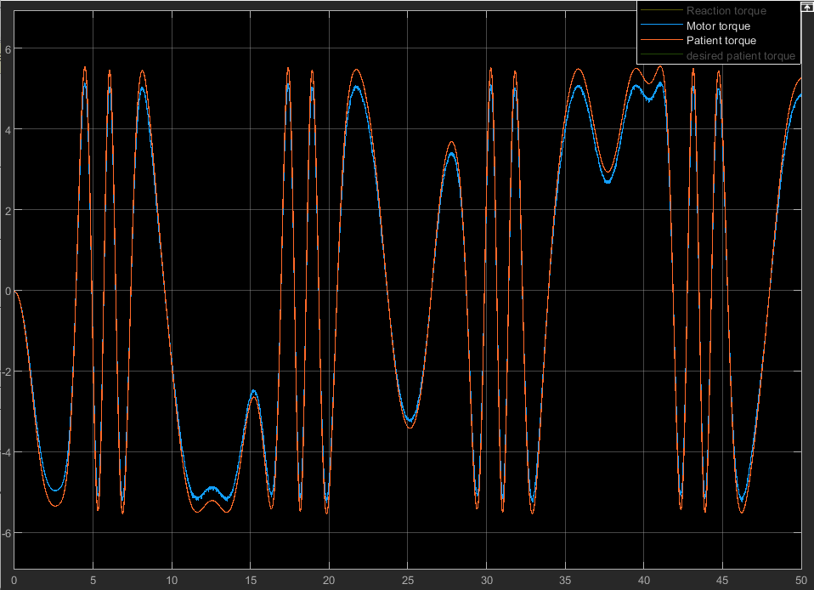
Key Results 2: When Patient Applies the Desired Patient Torque (100% Effort)
Step-1 Results:
The overall system follows the desired trajectory, and the corresponding patient torque and motor torque are measured.
Here, since it is assumed that there is enough effort provided by the patient, the desired patient torque and the applied patient torque are the same.
6

Slide 8
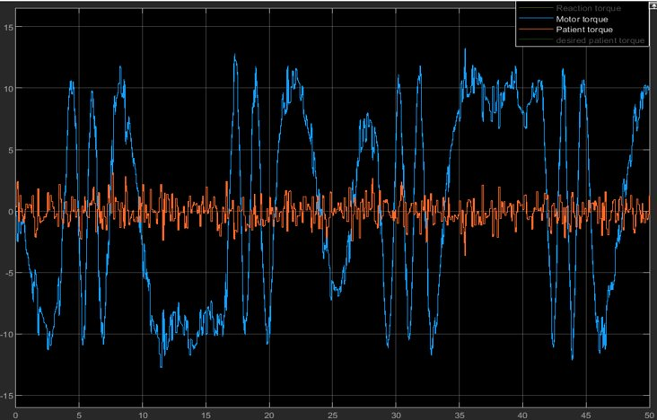
Key Results 3: When Patient Torque is a Random Disturbance
Step-2 Results:
The system follows the trajectory even when there is a random disturbance (from the patient’s efforts) instead of a known (desired) patient torque.
The control parameters are unchanged, and the controller is able to control the system even in this case.
7

Slide 9
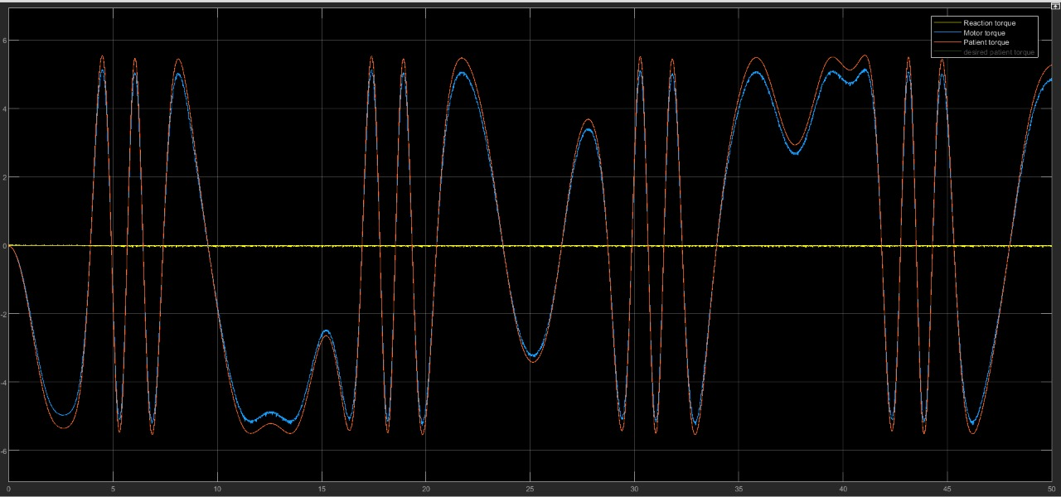
Key Results 4: Reaction Torque when Patient Effort is 100 %
Results:
Since the patient is able to put in 100% effort, the exoskeleton is not supposed to put in any effort to move the limb and thus, there is almost zero reaction torque between the limb and the exoskeleton link, as expected.
8

Slide 10
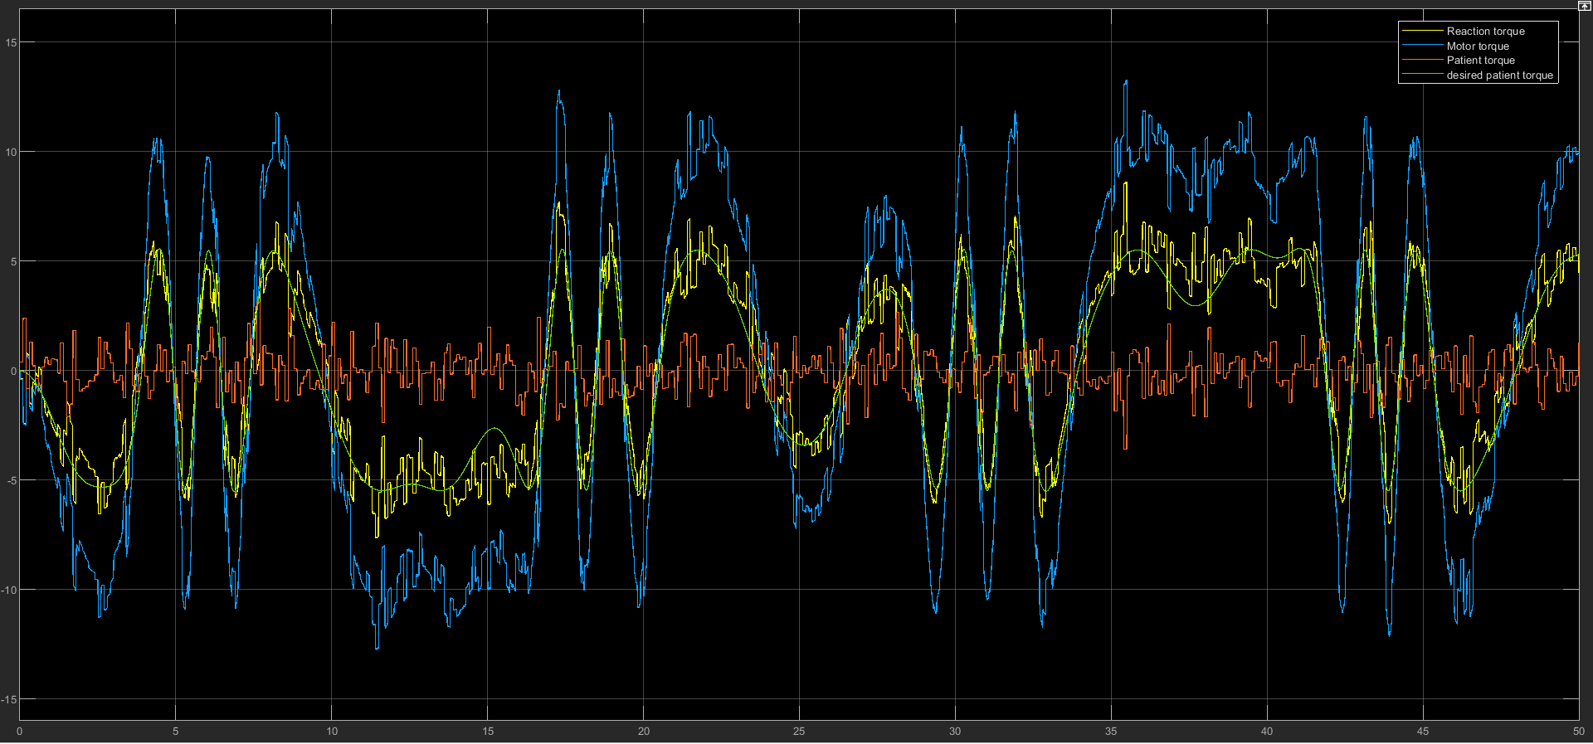
Key Results 5: Reaction Torque when Patient Effort is a Random Disturbance
Results:
Now, the patient effort is a random disturbance, therefore the reaction torque between the limb and the exoskeleton need no be zero and hence it shows up on the graph. Notice that the motor torque has also changed, accommodating the lead or lag in the patient torque from the desired patient torque.
9

Slide 11
Insights / Interim Conclusions / Discussion:
As expected and desired, in the first case when the patient effort is 100%, there is no interaction force and the graph shows the same.
In step 2, when the patient torque is added as a random disturbance to the system, one can see that the motor torque is higher than before, compensating for the lead/lag of the actual patient torque from the desired patient torque.
We also measure the patient torque which follows a random trajectory and therefore the interaction torque arises. The reaction torque can calculated from the motor dynamics (see Appendix).
How it Works: Consider the disturbance added in step-2 and determine the actual trajectory of the overall system. Determine the motor torque from the control law. Since the overall dynamics incorporates the motor torque and the patient torque, and since the motor torque and actual trajectory is known, one can find the unknown patient torque from the dynamic equations of motion.
10

Slide 12

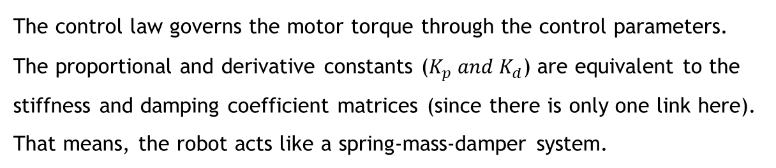
APPENDIX:
Control Law: $τ=K\left(q_{d}−q\right)+D\left(\dot{q_{d}}−\dot{q}\right)+M\left(q\right)\ddot{q_{d}}+C\left(q,\dot{q}\right)+g(q)$
Where,
$$M\left(q\right)=Inertia Matrix$$
$$C\left(q,\dot{q}\right)=Damping Terms \\ g\left(q\right)=\frac{mgl}{2}\sin\left(q\right) \\ K=Stiffness Coefficient Matrix \\ D=Damping Coefficient Matrix$$
The control law governs the motor torque through the control parameters. The proportional and derivative constants ($K_{p} and K_{d}$) are equivalent to the stiffness and damping coefficient matrices (since there is only one link here). That means, the robot acts like a spring-mass-damper system.
11

Slide 13
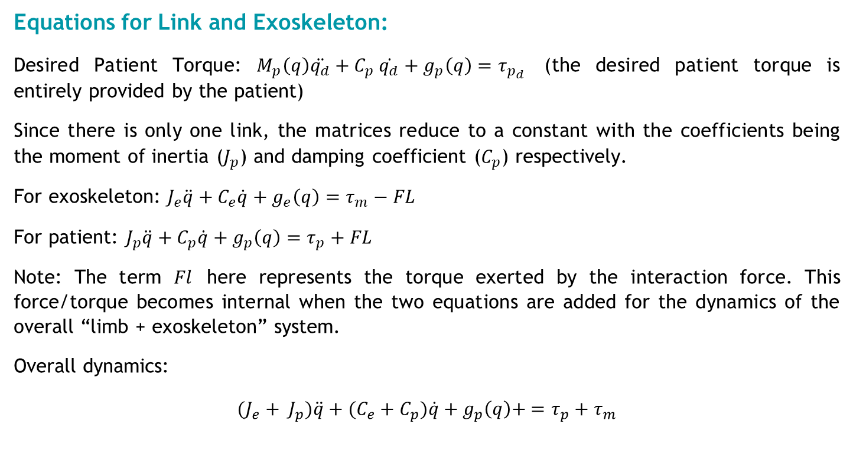
Equations for Link and Exoskeleton:
Desired Patient Torque: $M_{p}\left(q\right)\ddot{q_{d}}+C_{p} \dot{q_{d}}+g_{p}\left(q\right)=τ_{p_{d}}$ (the desired patient torque is entirely provided by the patient)
Since there is only one link, the matrices reduce to a constant with the coefficients being the moment of inertia ($J_{p}$) and damping coefficient ($C_{p}$) respectively.
For exoskeleton: $J_{e}\ddot{q}+C_{e}\dot{q}+g_{e}\left(q\right)=τ_{m}−FL$
For patient: $J_{p}\ddot{q}+C_{p}\dot{q}+g_{p}\left(q\right)=τ_{p}+FL$
Note: The term $Fl$ here represents the torque exerted by the interaction force. This force/torque becomes internal when the two equations are added for the dynamics of the overall “limb + exoskeleton” system.
Overall dynamics:
$${(J_{e}+ J}_{p})\ddot{q}+{(C_{e}+C}_{p})\dot{q}+g_{p}\left(q\right)+ =τ_{p}+τ_{m}$$
12

Slide 14
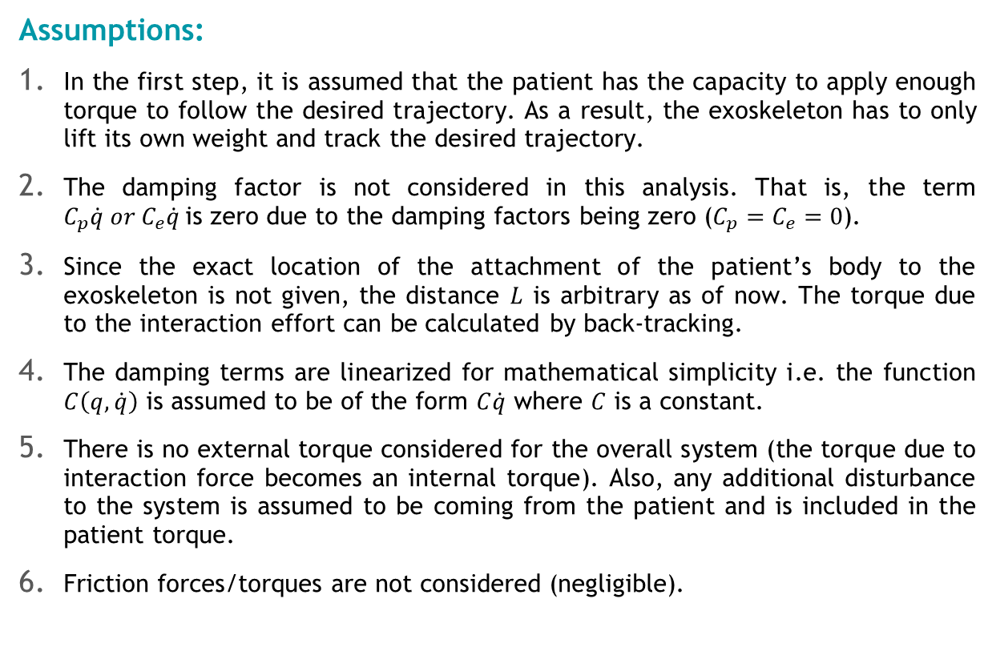
Assumptions:
In the first step, it is assumed that the patient has the capacity to apply enough torque to follow the desired trajectory. As a result, the exoskeleton has to only lift its own weight and track the desired trajectory.
The damping factor is not considered in this analysis. That is, the term $C_{p}\dot{q} or C_{e}\dot{q}$is zero due to the damping factors being zero ($C_{p}=C_{e}=0$).
Since the exact location of the attachment of the patient’s body to the exoskeleton is not given, the distance $L$ is arbitrary as of now. The torque due to the interaction effort can be calculated by back-tracking.
The damping terms are linearized for mathematical simplicity i.e. the function $C\left(q,\dot{q}\right)$ is assumed to be of the form $C\dot{q}$ where $C$ is a constant.
There is no external torque considered for the overall system (the torque due to interaction force becomes an internal torque). Also, any additional disturbance to the system is assumed to be coming from the patient and is included in the patient torque.
Friction forces/torques are not considered (negligible).
13

Slide 15
POSSIBLE FUTURE WORK: VARIABLE IMPEDANCE CONTROL
Our work includes the two cases: 0% patient effort and 100% patient effort.
We applied standard impedance control for the exoskeleton system. An advanced approach to the problem at hand would be of Variable Impedance Control (VIC) which adds flexibility to the controller and increases the efficiency of the robot.
In VIC, variable stiffness and variable damping is introduced, and the impedance control law will be variable. Therefore, in a VIC system, the robot senses the human intention by using the time derivatives of the applied forces and accordingly adjusts the damping or the stiffness parameter.
This control strategy is further exploited by a Variable Impedance Learning Control, where the robot attempts to directly learn a variable impedance control, using either imitation, iterative, or reinforcement learning.
14

Slide 16
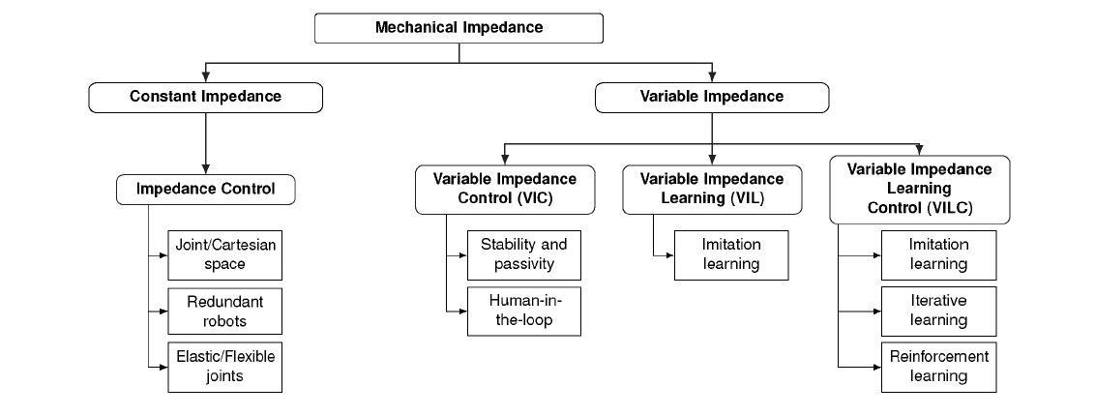
EXISTING APPROACHES FOR VARIABLE IMPEDANCE LEARNING/CONTROL
The approaches are designed to ensure the physical compatibility of the robot with the environment. That is, it avoids large impact forces or position uncertainties and provides a dynamic relation between the position and the force.
15

Slide 17
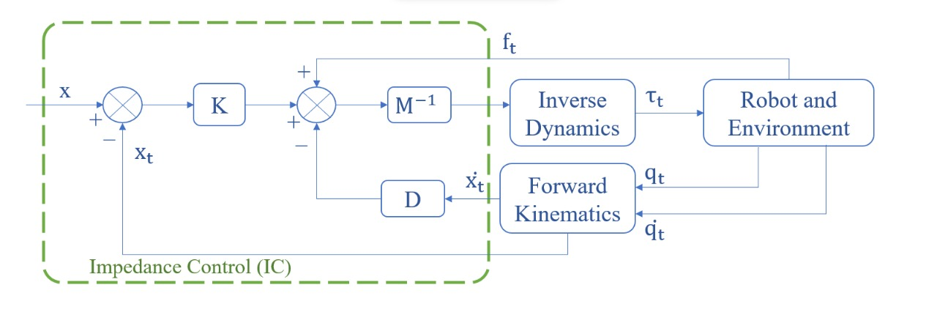
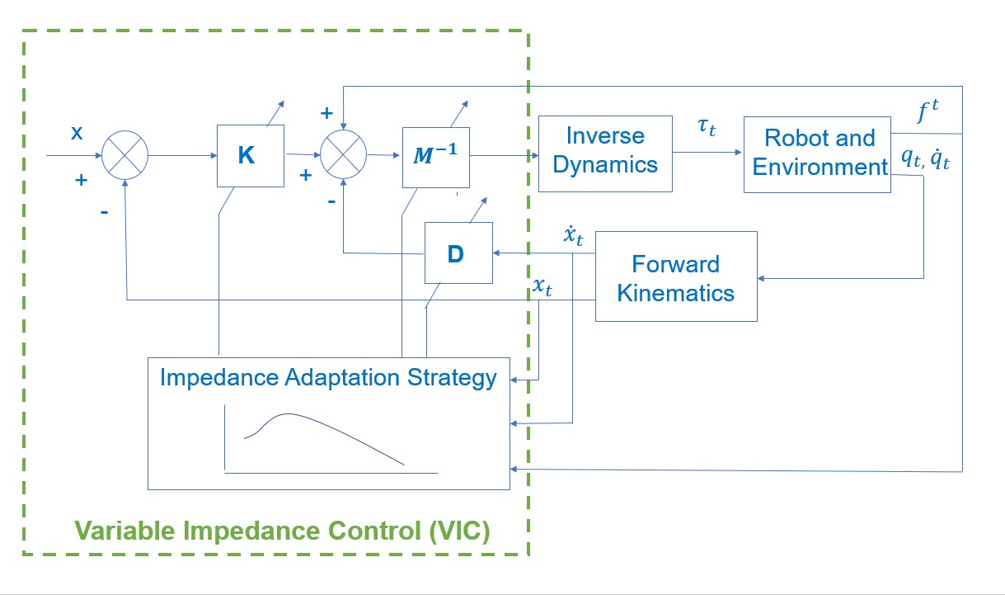
IMPEDANCE CONTROL V/S VARIABLE IMPEDANCE CONTROL
As compared to the standard impedance model, the VIC needs an Adaptation Strategy that regulates the values of the gains or the stiffness and the damping parameters in order to incorporate the external forces/torques from the physical environment.
Standard Impedance Control
Reference Paper for Variable Impedance Control: Link
Variable Impedance Control (VIC)
16

Slide 18
THANK YOU! ~ The Usual Suspects

